Slide 1
Dan Jurafsky and James Martin
Speech and Language Processing
Chapter 6:
Vector Semantics

Slide 2
What do words mean?
First thought: look in a dictionary
http://www.oed.com/

Slide 3
Words, Lemmas, Senses, Definitions
lemma
sense
definition

Slide 4
Lemma pepper
Sense 1: spice from pepper plant
Sense 2: the pepper plant itself
Sense 3: another similar plant (Jamaican pepper)
Sense 4: another plant with peppercorns (California pepper)
Sense 5: capsicum (i.e. chili, paprika, bell pepper, etc)

Slide 5
A sense or “concept” is the meaning component of a word

Slide 6
There are relations between senses

Slide 7
Relation: Synonymity
Synonyms have the same meaning in some or all contexts
filbert / hazelnut
couch / sofa
big / large
automobile / car
vomit / throw up
Water / H₂0

Slide 8
Relation: Synonymity
Note that there are probably no examples of perfect synonymy.
Even if many aspects of meaning are identical
Still may not preserve the acceptability based on notions of politeness, slang, register, genre, etc.
The Linguistic Principle of Contrast:
Difference in form -> difference in meaning

Slide 9
Relation: Synonymity?
Water/H₂0
Big/large
Brave/courageous

Slide 10
Relation: Antonymy
Senses that are opposites with respect to one feature of meaning
Otherwise, they are very similar!
dark/light short/long fast/slow rise/fall
hot/cold up/down in/out
More formally: antonyms can
define a binary opposition
or be at opposite ends of a scale
long/short, fast/slow
Be reversives:
rise/fall, up/down

Slide 11
Relation: Similarity
Words with similar meanings. Not synonyms, but sharing some element of meaning
car, bicycle
cow, horse

Slide 12
Ask humans how similar 2 words are
word1 | word2 | similarity
vanish | disappear | 9.8
behave | obey | 7.3
belief | impression | 5.95
muscle | bone | 3.65
modest | flexible | 0.98
hole | agreement | 0.3
SimLex-999 dataset (Hill et al., 2015)

Slide 13
Relation: Word relatedness
Also called "word association"
Words be related in any way, perhaps via a semantic frame or field
car, bicycle: similar
car, gasoline: related, not similar

Slide 14
Semantic field
Words that
cover a particular semantic domain
bear structured relations with each other.
hospitals
surgeon, scalpel, nurse, anaesthetic, hospital
restaurants
waiter, menu, plate, food, menu, chef,
houses
door, roof, kitchen, family, bed

Slide 15
Relation: Superordinate/ subordinate
One sense is a subordinate of another if the first sense is more specific, denoting a subclass of the other
car is a subordinate of vehicle
mango is a subordinate of fruit
Conversely superordinate
vehicle is a superordinate of car
fruit is a subordinate of mango
Superordinate | vehicle | fruit | furniture
Subordinate | car | mango | chair

Slide 16
So far
Concepts or word senses
Have a complex many-to-many association with words (homonymy, multiple senses)
Have relations with each other
Synonymy
Antonymy
Similarity
Relatedness
Superordinate/subordinate
Connotation

Slide 17
But how to define a concept?

Slide 18
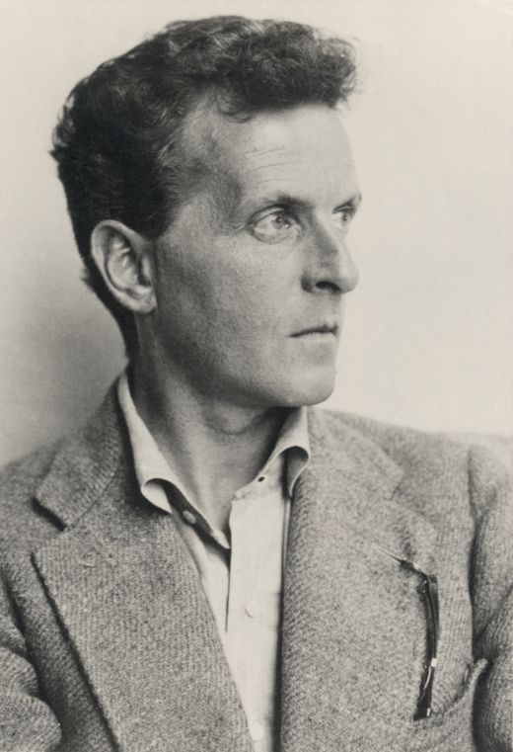
Ludwig Wittgenstein (1889-1951)
Philosopher of language
In his late years, a proponent of studying “ordinary language”

Slide 19
Ludwig Wittgenstein
PI #43:
"The meaning of a word is its use in the language"

Slide 20
Let's define words by their usages
In particular, words are defined by their environments (the words around them)
Zellig Harris (1954): If A and B have almost identical environments we say that they are synonyms.

Slide 21
What does ongchoi mean?
Suppose you see these sentences:
Ong choi is delicious sautéed with garlic.
Ong choi is superb over rice
Ong choi leaves with salty sauces
And you've also seen these:
…spinach sautéed with garlic over rice
Chard stems and leaves are delicious
Collard greens and other salty leafy greens
Conclusion:
Ongchoi is a leafy green like spinach, chard, or collard greens

Slide 22

Ong choi: Ipomoea aquatica "Water Spinach"
Yamaguchi, Wikimedia Commons, public domain

Slide 23
We'll build a new model of meaning focusing on similarity
Each word = a vector
Not just "word" or word45.
Similar words are "nearby in space"

Slide 24
We define a word as a vector
Called an "embedding" because it's embedded into a space
The standard way to represent meaning in NLP
Fine-grained model of meaning for similarity
NLP tasks like sentiment analysis
With words, requires same word to be in training and test
With embeddings: ok if similar words occurred!!!
Question answering, conversational agents, etc

Slide 25
We'll introduce 2 kinds of embeddings
Tf-idf
A common baseline model
Sparse vectors
Words are represented by a simple function of the counts of nearby words
Word2vec
Dense vectors
Representation is created by training a classifier to distinguish nearby and far-away words

Slide 26
Term-document matrix
Each document is represented by a vector of words

Slide 27
Visualizing document vectors

Slide 28
Vectors are the basis of information retrieval
Vectors are similar for the two comedies
Different than the history
Comedies have more fools and wit and fewer battles.

Slide 29
Words can be vectors too
battle is "the kind of word that occurs in Julius Caesar and Henry V"
fool is "the kind of word that occurs in comedies, especially Twelfth Night"

Slide 30
More common: word-word matrix (or "term-context matrix")
Two words are similar in meaning if their context vectors are similar

Slide 32
Reminders from linear algebra
vector length

Slide 33
Cosine for computing similarity
Sec. 6.3
v_{i} is the count for word v in context i
w_{i} is the count for word w in context i.
Cos(v,w) is the cosine similarity of v and w
Notes:
See Law of Cosines (Cosine Rule) wikipedia page

Slide 34

Cosine as a similarity metric
-1: vectors point in opposite directions
+1: vectors point in same directions
0: vectors are orthogonal
Frequency is non-negative, so cosine range 0-1

Slide 35
 | large | data | computer
apricot | 1 | 0 | 0
digital | 0 | 1 | 2
information | 1 | 6 | 1
Which pair of words is more similar?
cosine(apricot,information) =
cosine(digital,information) =
cosine(apricot,digital) =

Slide 36
Visualizing cosines (well, angles)

Slide 37
But raw frequency is a bad representation
Frequency is clearly useful; if sugar appears a lot near apricot, that's useful information.
But overly frequent words like the, it, or they are not very informative about the context
Need a function that resolves this frequency paradox!

Slide 38
tf-idf: combine two factors
tf: term frequency. frequency count (usually log-transformed):
Idf: inverse document frequency: tf-
Total # of docs in collection
Words like "the" or "good" have very low idf
# of docs that have word i
tf-idf value for word t in document d:

Slide 39
Summary: tf-idf
Compare two words using tf-idf cosine to see if they are similar
Compare two documents
Take the centroid of vectors of all the words in the document
Centroid document vector is:

Slide 40
An alternative to tf-idf
Ask whether a context word is particularly informative about the target word.
Positive Pointwise Mutual Information (PPMI)

Slide 41
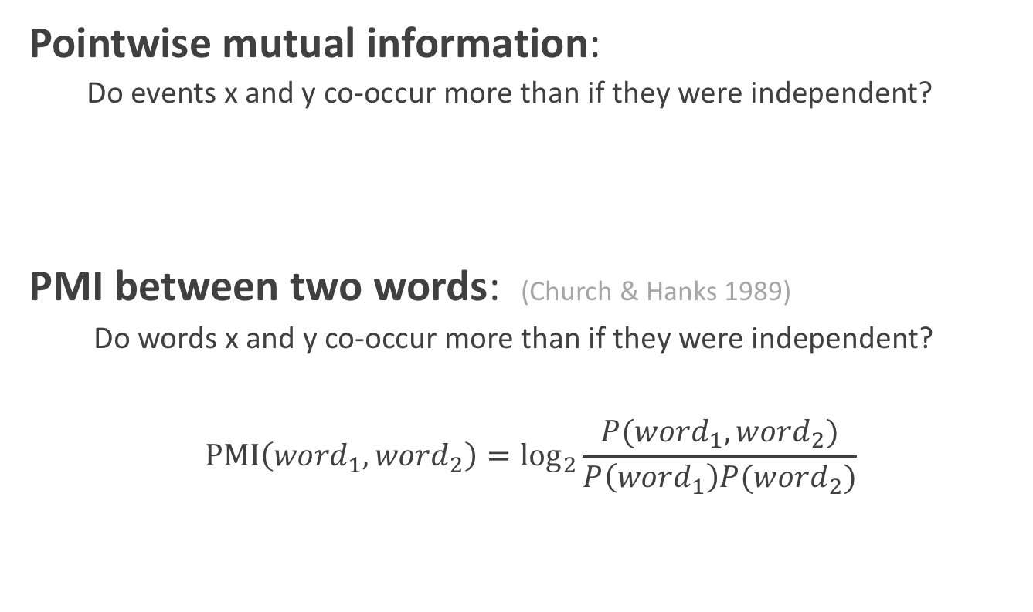
Pointwise Mutual Information
Pointwise mutual information:
Do events x and y co-occur more than if they were independent?
PMI between two words: (Church & Hanks 1989)
Do words x and y co-occur more than if they were independent?
$$\text{PMI}\left({word}_{1}, {word}_{2}\right)={\text{log}}_{2}\frac{P({word}_{1}, {word}_{2})}{P\left({word}_{1}\right)P({word}_{2})}$$

Slide 42
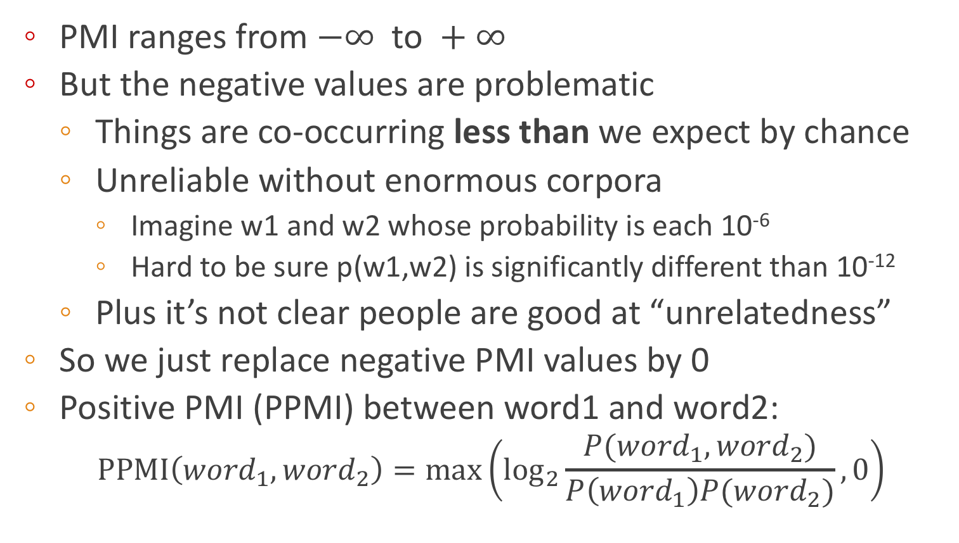
Positive Pointwise Mutual Information
PMI ranges from $−∞ \text{to} +∞$
But the negative values are problematic
Things are co-occurring less than we expect by chance
Unreliable without enormous corpora
Imagine w1 and w2 whose probability is each 10⁻⁶
Hard to be sure p(w1,w2) is significantly different than 10⁻¹²
Plus it’s not clear people are good at “unrelatedness”
So we just replace negative PMI values by 0
Positive PMI (PPMI) between word1 and word2:
$$\text{PPMI}\left({word}_{1}, {word}_{2}\right)=\max\left({\text{log}}_{2}\frac{P({word}_{1}, {word}_{2})}{P\left({word}_{1}\right)P({word}_{2})},0\right)$$

Slide 43
Computing PPMI on a term-context matrix
Matrix F with W rows (words) and C columns (contexts)
f_{ij} is # of times w_{i} occurs in context c_{j}

Slide 44
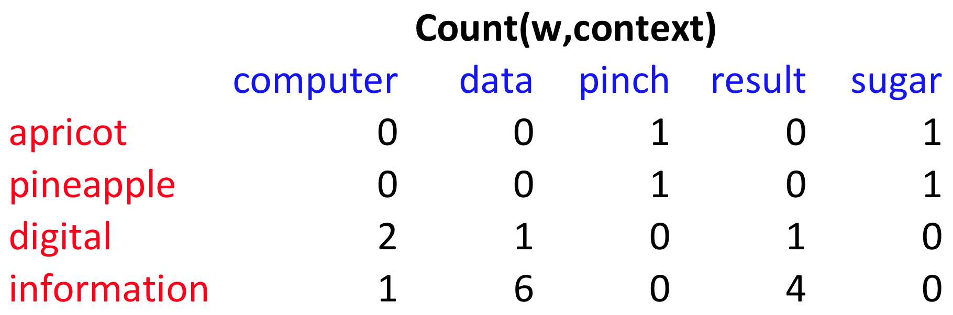
p(w=information,c=data) =
p(w=information) =
p(c=data) =
6/19
= .32
11/19
= .58
7/19
= .37

Slide 45
pmi(information,data) = log₂ (
.32 /
(.37*.58) )
= .58
(.57 using full precision)

Slide 46
Weighting PMI
PMI is biased toward infrequent events
Very rare words have very high PMI values
Two solutions:
Give rare words slightly higher probabilities
Use add-one smoothing (which has a similar effect)

Slide 47
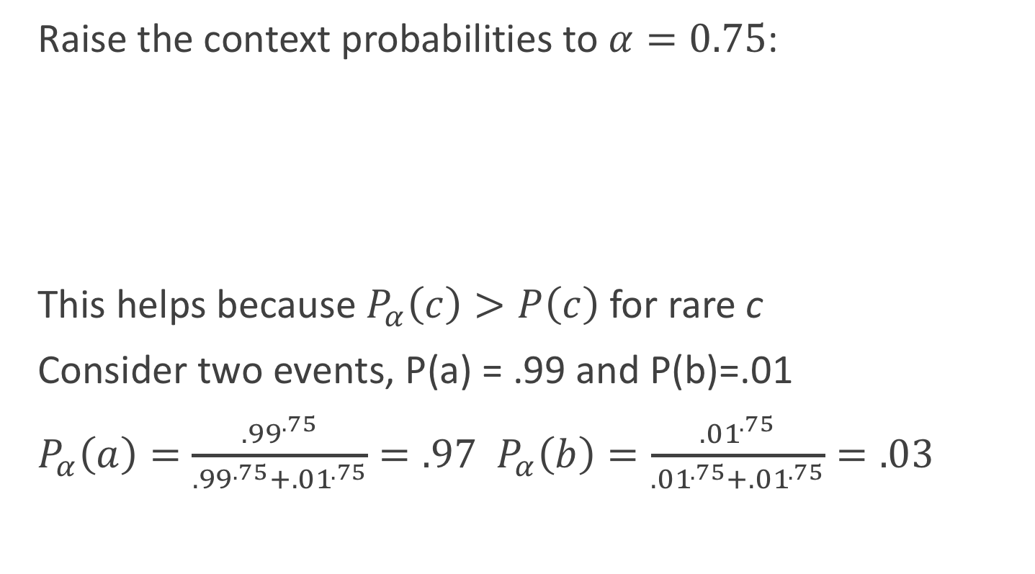
Weighting PMI: Giving rare context words slightly higher probability
Raise the context probabilities to $α=0.75$:
This helps because $P_{α}\left(c\right)>P\left(c\right)$ for rare c
Consider two events, P(a) = .99 and P(b)=.01
$P_{α}\left(a\right)=\frac{{.99}^{.75}}{{.99}^{.75}+{.01}^{.75}}=.97$ $P_{α}\left(b\right)=\frac{{.01}^{.75}}{{.01}^{.75}+{.01}^{.75}}=.03$

Slide 48
Use Laplace (add-1) smoothing

Slide 50
PPMI versus add-2 smoothed PPMI

Slide 51
Summary for Part I
Survey of Lexical Semantics
Idea of Embeddings: Represent a word as a function of its distribution with other words
Tf-idf
Cosines
PPMI
Next lecture: sparse embeddings, word2vec

